Slide 1
Azure Networking 101
ACE Solutions Architecture Team

Slide 2
Azure Hierarchy
Microsoft Entra ID (Formerly known as Azure AD) Tenant
Management Group
Azure PAYG
Microsoft 365
Dynamics 365
Trial
Subscriptions
Rg1
Rgn
Resource Groups
R1
Rn
Resources
Notes:
This is the hierarchy of resources in Azure. There is always an Azure Active Directory tenant that gets instantiated for you.
Think about this as the organization root, from here you can create multiple accounts that are called subscriptions and obviously, you can also have subscriptions for some of the SaaS services that Microsoft provides,, but here we are focusing on Azure itself, therefore we can have some accounts that are used for Dev, other for Test, others are used by the finance department.
Then in order to manage these accounts, you can have a folder structure, similar to an organizational unit in AWS, and this folder is called Management Group.
So you have the root of the hierarchy being the organization, subsequently you can have other sub-groups.
Then in Azure there is an important concept, that is called resource group: A RESOURCE GROUP IS A LOGICAL CONTAINER FOR ENCOMPASSING resources that interact together.
This structure allows to define who can access the resources and their level of privileges, but it is also useful on the billing front. And then we have the resources themselves.

Slide 3
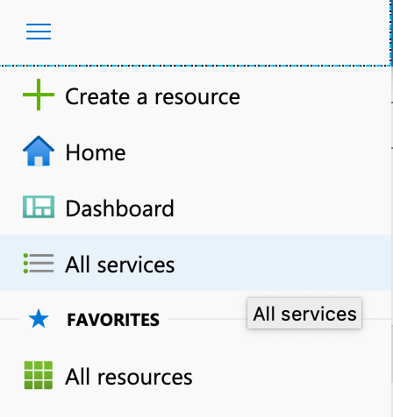
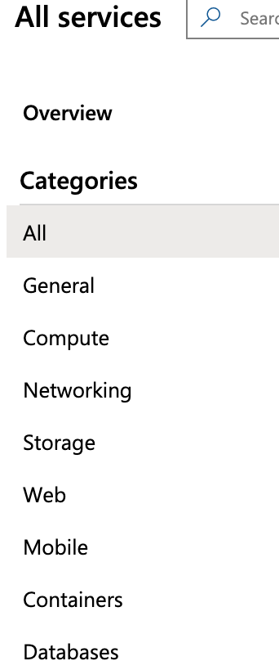
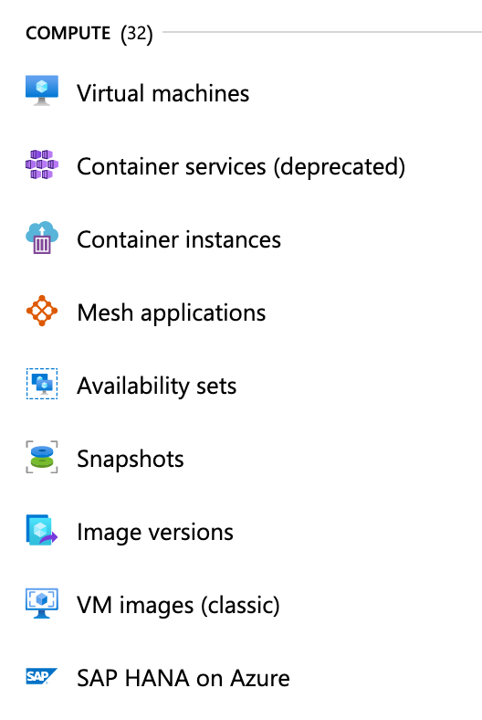
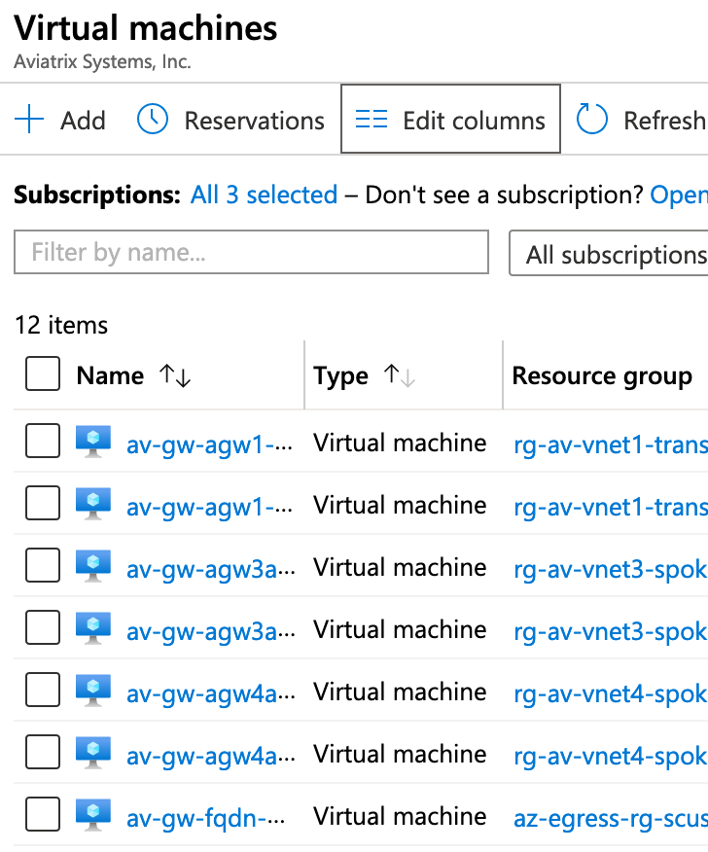
Microsoft Azure Service and Resource
Ability to See All Services | List of Service (categories) | Resources are grouped inside each Service | Resource is an instance of a Service in a Resource Group
Notes:
The resources can be anything from a virtual machine, a network interface to a container instance. this is the dashboard where you can see all the services and then these are really categories of services, so you can choose for example the compute services, and once you click on compute you will see that there are different resources or different sub services that are grouped inside the service. For example, you can go for a virtual machine or you can go for a container, or you can do a snapshot.
All of these really are the sub services

Slide 4
Azure Service Categories
Category Name | Example Services
Compute | Virtual Machines, WebApps, Virtual Machine Scale Sets, Azure Virtual Desktop
Storage | Blob Storage, Disk Storage, Azure NetApp Files
Networking | Virtual Network, DNS, VPN Gateway, ExpressRoute, CDN
Databases | Azure SQL, Azure Cosmos DB, Azure Cache for Redis
Containers | Azure Kubernetes Service, Azure Red Hat OpenShift, Container Registry, Container Instances
Identity | Azure Active Directory
Security | Microsoft Defender for Cloud, Azure Sentinel, Azure Firewall, Web Application Firewall
AI + Machine Learning | Azure Databricks, Azure Cognitive Services
Notes:
This slide shows the azure terminology

Slide 5



Azure Core Networking Services
Virtual Network
Network Interface
Public IP Address
Subnets
DNS
Address space can be one or more networks either public or private
Provides full Layer 3 semantics and partial Layer 2 semantics (DHCP, ARP, no broadcast/multicast)
Provides network services to virtual machines
Provides name resolution services for resources deployed in Virtual Networks and the Internet
Provides communication from the Internet to services deployed in a Virtual Network
Isolated, logical network providing connectivity for virtual machines and some PaaS services
Networks within a VNet which can be used for more granular separation of virtual machines
Up to 8 NICs supported on a VM depending on the SKU.
All NICs must belong to the same Virtual Network
All VMs in a VNet belong to the same internal DNS zone by default. It is possible to create custom public and private DNS Zones
Can be static or dynamic. Assigned by Microsoft
Used for Internet inbound connectivity
Notes:
The Vnet is you address space, your isolated network where you can put your VMs and workloads.
When you define a VNet you also define the cidr or a super block
(click)
The subnets are portions of the supernet that you defined into the vnet.
The only difference with AWS, is that in Azure the subnets can span multiple availability zones or they can be constrained into a specific availability zone. Ultimately, in azure the subnets haev the capability to be across multiple Azs, therefore you cane xtend the L2 within a region.
(click)
Route table basically control and govern the traffic by means of routes
(click)
The UDR refers to system routes, for instance when you assign the cidr block inside the Vnet, that route will be automatically defined in Azure as local, but you might want to insert static routes that point to a NGFW, all of these are what Azure call UDR, that are basically static routes that overrule other routes such as the system routes
(click)
The azure load balancer can be internal or external, it means that it could be public facing or it could be within Azure.
The azure load balancer is a network load balancer, this means that it operates at L4, versus an application Gateway version2 that operates at L7

Slide 6






Azure Networking IP Routing Services
Route Tables
Azure Route Server
Virtual & Local Network Gateways
ExpressRoute Circuits
Virtual Network Peering
Provides static routing inside Azure
Provides a BGP interface to dynamically exchange routes with Azure fabric
Provides connectivity between Azure Virtual Networks and private networks outside of Azure
Provides a dedicated communication channel between private networks and Azure services
Provides a way to bridge two Virtual Networks together
Up to 400 user defined routes (UDR - static routes)
Must be manually configured and maintained
Single next-hop per destination
Facilitates integration with SD-WAN solutions by providing dynamic routing between Azure and NVAs
Over the Internet using IPsec encryption or through a dedicated connection using ExpressRoute
Up to 10 Gbps when going through a provider and up to 200 Gbps when connecting directly
Point to point and non-transitive
Hosts in both VNets communicate directly with each other by default
Notes:
VPN and ExpressRoute Gateways are different and independent
A VNet can only have one Gateway of each type
No transitivity between VPN and ExpressRoute by default, requires Azure Route Server
VPN Gateway can support up to 100 VPN tunnels (depends on the SKU)
VPN Gateway throughput is aggregate across all tunnels
Each VPN tunnel is limited to ~2Gbps if using GCM ciphers and ~700Mbps if using CBC ciphers
Routes learned from VPN + ExpressRoute + Azure Route Server <= 10K
500 peered VNets limit
Route Tables
Azure Route Server
Virtual and Local Network GWs: VPN or Exrpess Route ERGW
Local Network Gateway: Customer GW in AWS
ExpressROute Circuits: DC

Slide 7








Azure Networking Security Services
Network & Application Security Groups
Web Application Firewall
DDoS Protection
Private Endpoint & Private Link
Azure Firewall
Stateful L3/L4 distributed firewall
Stateful L3/L4 centralized firewall with IDS/IPS and Deep Packet Inspection capabilities
Purpose specific firewall for HTTP/HTTPS workloads
Protects public facing resources against DDoS attacks from the Internet
Provides an interface in a Virtual Network to connect to PaaS/SaaS services over private networks
Rules are processed in priority.
Can be applied at the NIC, Subnet level or both
Requires UDRs to steer traffic towards it.
Supports TCP and UDP
No WAF capabilities
Can be used with Application Gateway, Front Door and Azure CDN services.
Can leverage OWASP and custom rules
Basic protection for Azure platform, not individual workloads. Standard protection can be tuned
Use to access Azure PaaS services or to privately expose SaaS services to multiple customers
Notes:
Up to 1,000 rules per NSG

Slide 8





Azure Load Balancing Services
Load Balancer
Application Gateway
Azure Front Door
Azure Traffic Manager
NAT Gateway
Provides L3/L4 Load Balancing for TCP and UDP traffic
Application Delivery Controller for HTTP, HTTPS and WebSockets
Global ADC for HTTP and HTTPS traffic. No WebSockets support
DNS based global load balancer
Provides a stable IP address for outbound Internet connectivity
External or Internal
Uses 5-tuple, 3-tuple or 2-tuple hash algorithm
Preserves client IP address (no SNAT)
External or External + Internal
Supports TLS termination and E2E TLS
Routing decisions based on HTTP headers
Provides CDN, TCP acceleration and WAF services
Relies on anycast to ingest traffic closest to the clients
Doesn’t sit in the data path
Tied to client DNS behavior
Supports 6 different routing methods
Associated to a subnet
Provides 64K ports per public IP address
Notes:
Up to 100 listeners per Application Gateway
Traffic Manager Routing methods:
Priority
Weighted
Performance
Geographic
Multivalue
Subnet

Slide 9
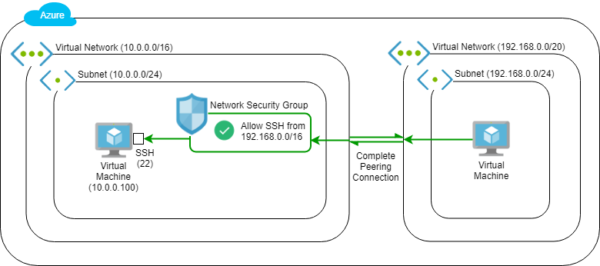

NSG
NSG can be at Subnet level or NIC level
You can have NO NSG at all
region
Notes:
Let’s visualize these services.
The region once again is just a collection of Availability zones, a set of DCs physically connected together with high speed and low latency links, and you usually deploy your workloads in the closest region as mentioned in AWS.
Here depicted in the picture we have two Virtual network, for isolation purposes, and inside the vnets we have our subnets.
Note that the subnet address stems from the cidr block.
Morevoer, we have VMs. The subnet will be associated with a route table, and the route table will govern what we can reach.
On top of that we have a concept called NSG, a firewall rule that we can be applied either at the level of the subnet protecting all the resources that are inside the subnet, or you can go to the micro level and use it on each network interface.
Both of these options are available in azure when we talk about NSG.
Now that we have two vnets how can they communicate to each other?
Similar to what we saw in aws with the concept of vpc peering, we are going to configure a vnet peering, basically telling the vnets that if each vnet wants to reach another vnet, they have to go through this connection. This connectivity leverages the private underlay , and this construct can be enabled within a region of across different regions

Slide 10
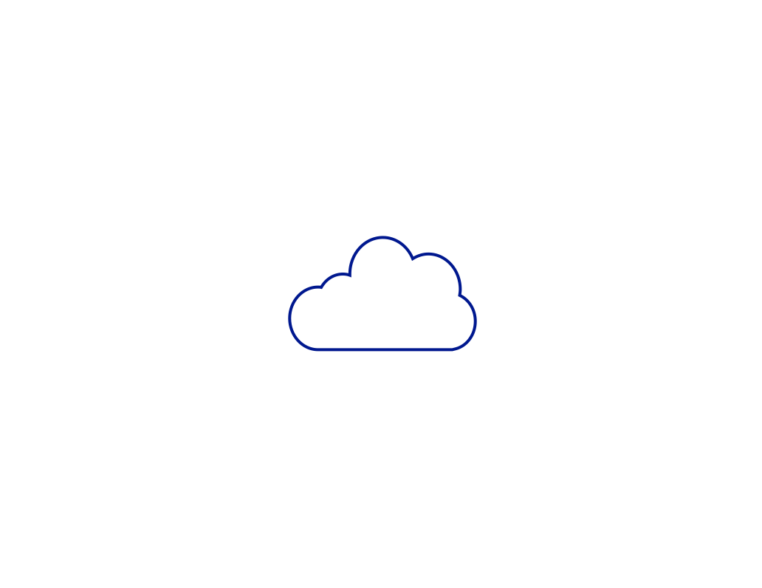



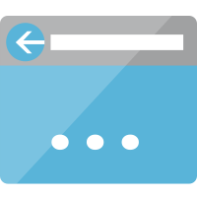
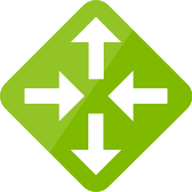
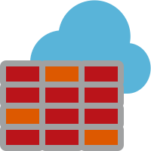
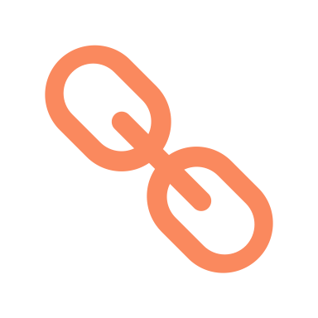

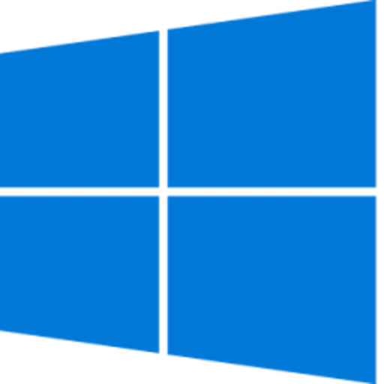
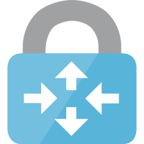




Azure Networking Components
Corp HQ
VNet (Virtual Network)
Routing: User-Defined Route (UDR), BGP and System Routes
Availability Zones (not all regions)
Network Security Group
Virtual Network Gateways
VPN Gateway (VNG)
S2S (max 30 tunnels) and P2S VPN
Local Network Gateway (on-prem entity)
ExpressRoute Gateway (ERGW)
Note: No communication path between VNG and ERGW
Public and Private IP Address
VNet Peering
NVA (Network Virtual Appliance)
VNet
Peering
VNet
VNet
Internet
Site-to-site VPN
Public IP
VNet
ExpressRoute
NVA
Region 1
ERGW
VNet
VNG
Point-to-site VPN
Region 2
Region 3
Branch
Branch
Branch
Branch
Notes:
Now, we discussed the vnet, we discussed the udr, in other words the static routes that override the other routes.
You can activate bgp if you are peering with external components.
In azure not all regions have availability zones, when you are architecting your applications.
The NSG is what we discussed before, it can be on top of the eni or on the edge of the subnet.
Now it terms of Gateways, there are two gateways that I would like to mention:
One of them is thet VPN gateway, and this is a termination point if you have a site-to-site vpn with an on-site router.
It can also be a point-to-site vpn, that is a remote access vpn solution
On top of that, there is also the express route gateway, which a priate termination for your express route connection 8very similar to what we saw before in aws with the direct connect)

Slide 11
Azure VNet Peering
Preferred Method by Microsoft Product Group for Transit in Azure
No Real BW Limitation
1-to-1 Mapping
Does not scale
No easy way to insert FWs
No granularity (all or none subnets)
VNet peering data charges for ingress and egress in both directions
Inter-region supported (Global VNet peering)
East US
Spoke VNet 1
Spoke VNet 2
Spoke VNet 3
VNet Peering
Spoke VNet 4
Spoke VNet 5
Notes:
The vnet peering allows the communication among vnets, but this is a 1-to-1 mapping, this means I need a full-mesh peerings, there is no concept of transitive peering.
Another downside of peering is that we cannot insert firewall, the traffic is going directly from one vnet to another

Slide 12

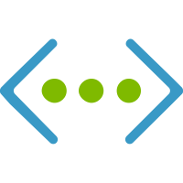

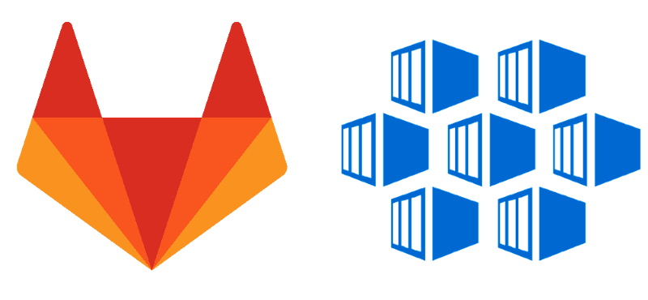




Transit in Azure
Transit is the most important part of any cloud network
Transit is responsible for scale out way of interconnecting VNets
It connects VNets within a region, across-regions, and with VNet equivalents (VPC, VNC, etc.) in other clouds
Azure official documentation recommends to use Transit VNet using VNet Peering
Transit with HUB VNet using VNet Peering is provided by the following Deployment models:
via ExpressRoute Edge routers
via Network Virtual Appliance in Transit/Hub VNet
Azure Cloud
Region
Region

Slide 13




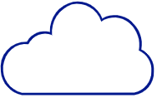





Single Virtual Network
Azure
Region
Deny traffic to Subnet-2
To AzFW
To ILB
To NVA-31
Deny traffic from VM-23
AZ-1
VM-11
VM-21
NVA-31
Internet
VM-12
VM-22
ILB
Azure Firewall
NVA-32
AZ-2
VM-13
VM-23
Subnet-1 10.0.0.0/24
Subnet-2 192.168.0.0/24
Subnet-3 10.0.1.0/24
VNet-A 10.0.0.0/16, 192.168.0.0/16

Slide 14

Internet Ingress
Azure
Region
Deny traffic to Subnet-2
To AzFW
To NVA-31
To ILB
Deny traffic from VM-23
AZ-1
VM-11
VM-21
NVA-31
Internet
ILB
Azure Firewall
Public IP Address
VM-12
VM-22
ELB
NVA-32
AZ-2
VM-13
VM-23
Subnet-1 10.0.0.0/24
Subnet-2 192.168.0.0/24
Subnet-3 10.0.1.0/24
VNet-A 10.0.0.0/16, 192.168.0.0/16

Slide 15
Internet Ingress with Gateway Load Balancer
Azure
Region
Internet
Deny traffic to Subnet-2
ELB
Deny traffic from VM-23
AZ-1
VM-11
VM-21
VM-12
VM-22
NVA-31
AZ-2
GWLB
VM-13
VM-23
NVA-32
Subnet-1 10.0.0.0/24
Subnet-2 192.168.0.0/24
Subnet-3 10.0.1.0/24
VNet-A 10.0.0.0/16, 192.168.0.0/16

Slide 16




Internet Ingress for Web Traffic
Azure
Region
Deny traffic to Subnet-2
Deny traffic from VM-23
AZ-1
WAF
VM-11
VM-21
WAF
Internet
VM-12
VM-22
Application Gateway
Azure FrontDoor
AZ-2
VM-13
VM-23
Subnet-1 10.0.0.0/24
Subnet-2 192.168.0.0/24
Subnet-3 10.0.1.0/24
VNet-A 10.0.0.0/16, 192.168.0.0/16

Slide 17




On Premises Connectivity
Azure
Region
Deny traffic to Subnet-2
To AzFW
To AzFW
To AzFW
Deny traffic from VM-23
On Premises
ExR
ExR
Circuit
AZ-1
VM-11
VM-21
VPN
GatewaySubnet 10.0.2.0/24
VM-12
VM-22
AZ-2
Internet
VM-13
VM-23
Azure Firewall
Subnet-1 10.0.0.0/24
Subnet-2 192.168.0.0/24
FirewallSubnet 10.0.1.0/24
VNet-A 10.0.0.0/16, 192.168.0.0/16

Slide 18



Azure Virtual WAN
Azure
Region 1
Azure
Region 2
Azure
Region 3
VNet-A1
VNet-B1
VNet-A2
VNet-B2
VNet-A3
VNet-B3
vWAN-HUB-1
vWAN-HUB-2
vWAN-HUB-3
vWAN
P2S User
ExpressRoute
S2S VPN
SD-WAN
Notes:
Virtual wan is like a hub and all the vnets get hooked up to this hub, in addition to for example your remote users or a branch or an sdwan.
The virtual wan becomes the focal point to which everybody GETS connected and this architecture is repeatable and can be extended into multiple regions.
However, there are several challenges that we need to take into account.
Only an azure firerwall can be deployed and more recently fortigate
Limitation in troubleshooting and visibility
Vnet-to.-vnet traffic inspection is not supported using a firewall in a spoke.
Custom route tables are complex to manage as the number of routing domains and hubs increase.

Slide 19
Azure Route Server
Azure Route Server is a fully managed service that allows you to easily manage routing between your network virtual appliance (NVA) and your virtual network.
No. Azure Route Server is a service designed with high availability. Your route server has zone-level redundancy if you deploy it in an Azure region that supports Availability Zones.
Notes:
Virtual wan is like a hub and all the vnets get hooked up to this hub, in addition to for example your remote users or a branch or an sdwan.
The virtual wan becomes the focal point to which everybody GETS connected and this architecture is repeatable and can be extended into multiple regions.
However, there are several challenges that we need to take into account.
Only an azure firerwall can be deployed and more recently fortigate
Limitation in troubleshooting and visibility
Vnet-to.-vnet traffic inspection is not supported using a firewall in a spoke.
Custom route tables are complex to manage as the number of routing domains and hubs increase.

Slide 20

SD-WAN Integration
Azure
Region
To AzFW
To AzFW
On Premises
ExR
ExR
Circuit
VM-11
RouteServer
VPN
RSSubnet 10.0.4.0/24
GatewaySubnet 10.0.2.0/24
VM-12
To ILB
ILB
Internet
VM-13
SDW-1
SDW-2
Azure Firewall
Subnet-1 10.0.0.0/24
SD-WAN 10.0.3.0/24
FirewallSubnet 10.0.1.0/24
VNet-A 10.0.0.0/16

Slide 21

Hub and Spoke
Azure
Region
To AzFW
To AzFW
On Premises
VM-11
ExR
Subnet-11
Route Server
VPN
VNet-A 10.1.0.0/16
RS Subnet 10.0.4.0/24
GW Subnet 10.0.2.0/24
ExR
Circuit
To AzFW
NVA-1
NVA-2
Azure Firewall
VM-21
NVA 10.0.3.0/24
Firewall Subnet 10.0.1.0/24
Internet
Subnet-21
HUB-VNet 10.0.0.0/16
VNet-B 10.2.0.0/16

Slide 22
Hub and Spoke – Multi-Region
Azure
Region 1
Azure
Region 2
To AzFW-1
ExR
Circuit
To AzFW-2
To AzFW-1
To AzFW-2
ExR
On Premises
ExR
VPN
VPN
VNet-A1
VNet-A2
To AzFW-2
To AzFW-1
To AzFW-1
Internet
To AzFW-2
AzFW-1
AzFW-2
Global VNet Peering
VNet-B1
HUB-1
HUB-2
VNet-B2

Slide 23
Azure Virtual WAN
Azure
Region 1
Azure
Region 2
Azure
Region 3
VNet-A1
VNet-B1
VNet-A2
VNet-B2
VNet-A3
VNet-B3
vWAN-HUB-1
vWAN-HUB-2
vWAN-HUB-3
vWAN
P2S User
ExpressRoute
S2S VPN
SD-WAN
Notes:
Global mesh of managed hub virtual networks that provides any to any connectivity across all entities connected to those hubs
Managed hub VNet:
Only supports deployment of:
ExR
S2S VPN
P2S VPN
Azure Firewall
Select 3rd Party SD-WAN solutions (Cisco Viptela, VMWare Velocloud, Barracuda CloudGen WAN, Fortinet Secure SD-WAN)
Recently supports FortiGate firewall
VNets are connected to the hubs using VNet peering in the backend
Each Hub provides up to 50Gbps throughput for VNet-to-VNet connectivity, within the same hub or across hubs, however only a fraction of that throughput is available from the get go and the hub needs to scale out (automatically using internal logic). It can take a couple of hours for the hub to fully scale out to support 50Gbps
ExR, S2S VPN and P2S VPN does not automatically scale out, available throughput is defined using scale units. For ExR 1 Scale Unit = 2Gbps, supports up to 10 scale units / 20Gbps. S2S VPN 1 scale unit = 500Mbps, supports up to 40 Scale Units / 20 Gbps, P2S supports up to 200 scale units / 200Gbps / 100,000 clients
Provides transit between S2S VPN / P2S VPN and ExR. This cannot be disabled
ExR to ExR transit can only be achieved via ExR global reach
Uses custom route tables to segregate traffic between VNets. Each RT can be thought of as a VRF (although address overlapping is not supported), as the number of cRTs / Segments increase it becomes cumbersome to manage and maintain. Branches can only be associated with the default RT
RTs only exist in the hub that they are created and cannot be reused across hubs, hence admins must duplicate the RTs in each hub and use labels for consistent traffic forwarding across hubs
Routes from branches and VNets propagating to a Route Table, as well as any static routes defined in the route table a VNet is associated to are automatically programmed in the Azure Fabric, those routes show as having “Next Hop Type Virtual Network Gateway”

Slide 24
Aviatrix can help Enterprises with …
Single operational model for Cloud and Aviatrix Equinix Edge
Migration of workload using Equinix Express Route Service
Cloud DR using Equinix
Equinix connectivity between AWS and Azure
High-Performance Encryption from Equinix to Azure
Extending the Cloud operating model to Equinix Edge locations
Extending Network and Micro-Segmentation across Clouds and Equinix Edge
Azure vWAN, AWS CloudWAN, etc., are single cloud options with limitations
Advanced BGP knobs / Advanced NAT / Mapped NAT / Overlapping IP Addresses
Single automation / terraform framework

Slide 25

















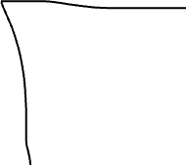

Slide 26
Next: GCP Networking 101

